Slide 1
Collection of Data
James age 10
Bob age 15
Joseph age 40
Frank age 50
Data
Report

Slide 2
Job of Database Developer
Maintain tables
Maintain relationships
Remove deprecated tables and fields
Create and maintain indexes
Backup and Restore databases
Write reports
Load data into database
Maintain Stored Procedures, Views, Triggers
Maintain 100% uptime of the database
Migrate data from server to server
Resolve data issues
Overall maintain production database and business continuity
Be a data expert

Slide 3
About Database
Database consists of
Database Files
Data
Indexes
Support Structure
Transaction Logs
Hold data from committed transactions to ensure consistency in the database.

Slide 4
ACID
ACID
Atomicity
Consistency
Isolation
Durability

Slide 5
Atomicity
All or nothing in every transaction
If one transaction fails, then the entire transaction fails
Database is left unchanged
Includes power failure
Unexpected or expected Errors
Application crushes
Database crushes
Server crushes
All unexpected events that prevent normal business processes

Slide 6
Consistency
Any transaction must ensure that database is valid before the statement begins and valid after statement finishes running
Data written to database is always valid and if integer is expected then integer is saved
Consistency does not guarantee that transaction is correct but it guarantees that data that is expected to be saved will be saved
If you wanted to save ‘James’ but provided ‘Jones’ means that data is consistent and they are both strings but it is incorrect data. Incorrect data is responsibility of the developer and not Consistency of the database

Slide 7
Isolation
Many transactions can use same venue of execution
Parallel or serial execution of transactions guarantees same execution to all transactions and all transactions will be processed by the database no mater how may are executed at the same time. All transactions are isolated from each other from start to finish.

Slide 8
Durability
If transaction is committed then it will remain committed even if database crushes or if some other error occurs later. Once transaction is committed then it is committed.
Once transaction is committed then it is committed to non volatile storage such as HD

Slide 9
Atomicity Failure
2 bank accounts
1 account writes a check to pay second account
Account 1: withdraw $100
Account 2: deposit $100
Before deposit can be made a power failure occurs
If transaction 1 stays in database then Atomicity failed because it must be all or none.
First transaction must be rolled back.

Slide 10
Consistency Failure
1 bank accounts same owner
1 Checking Account
1 Savings Account
Account 1: withdraw $100 from checking
Account 2: deposit $100 into savings
Total Account value before transfer $300 with $100 in savings and $200 in checking accounts
Between transactions a failure happens.
If transactions are not rolled back then customer will loose $100 as his total now will be $200 != $300

Slide 11
Isolation Failure
1 bank accounts same owner
1 Checking Account
$400 total cash in account
1 withdrawal for $100
Parallel transaction 1 withdrawal for $400
If both transactions are committed then account is negative (-$100)

Slide 12
Durability Failure
1 bank accounts same owner
1 Checking Account
1 Savings Account
We attempt to transfer $100 from checking to savings
Withdraw $100 from checking
Attempt to deposit $100 to savings
Notify user that transfer was successful
Power Fails and transaction is never recorded but user is notified that it was successful

Slide 13
What is Database
Resource Database
Critical System Tables
Metadata
Stored Procedures for SQL operations
Does not contain information about instances of the database (client databases)
Only service packs write to this database
Holds physical tables and stored procedures that are logically referenced by other databases

Slide 14
What is Database
Master Database
Contains metadata about your databases
Configuration
Location
Logins
Configuration information about instances

Slide 15
What is Database
Tempdb Database
Holds temporary objects created by user
Temporary objects needed by database
Row version information
Created each time SQL restarts
Cannot be backed up
Must have enough HD allocated for operations
Many tasks in database use TempDB
Set it to autogrow if needed
This is important part of optimization due to autogrow

Slide 16
What is Database
Model Database
Serves as model when new database is created
Model database is copied into new database instance
This rule does not apply if database is restored or attached from different database
You can include your own objects in Model Database so that when new database is created all your objects will be created as well

Slide 17
What is Database
Msdb Database
Is system database
Contains information about:
Agents
Log shipping
SSIS
Backup and Restore system for relational database
Job information
Operations
Alerts
Job History
Should be backed up often

Slide 18
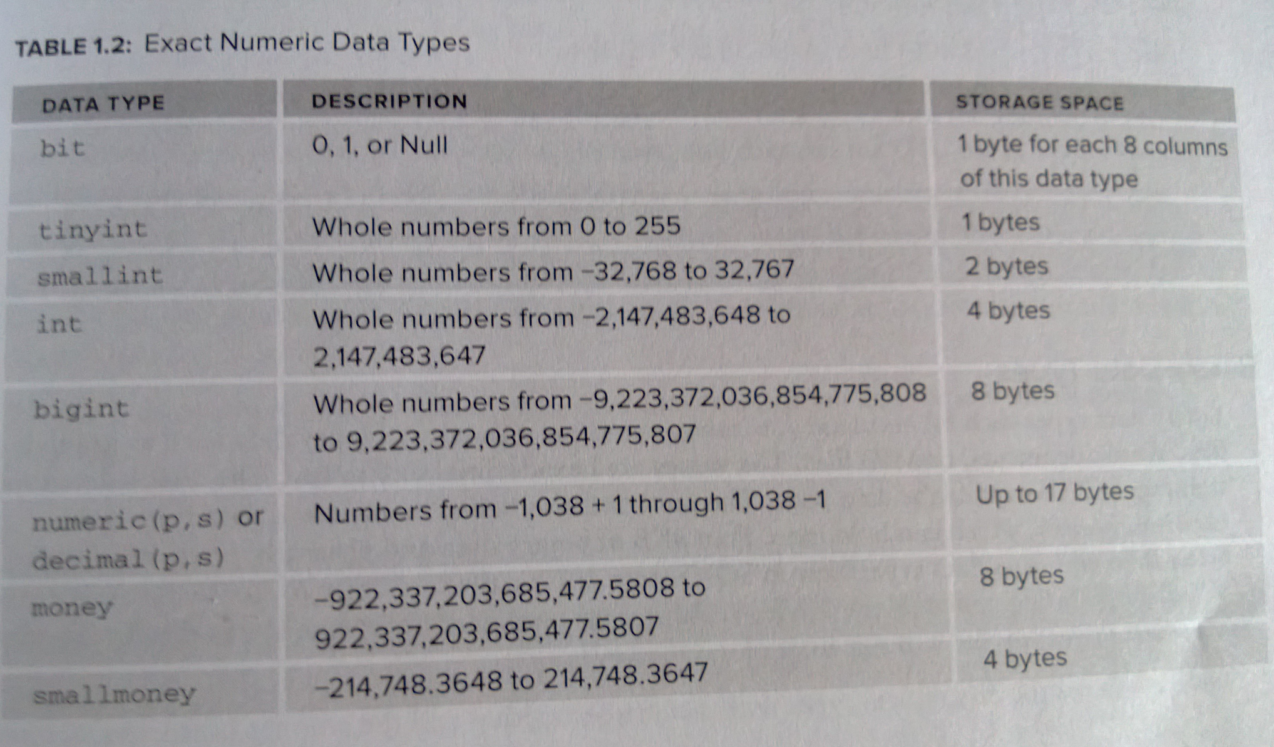
Data Types

Slide 19
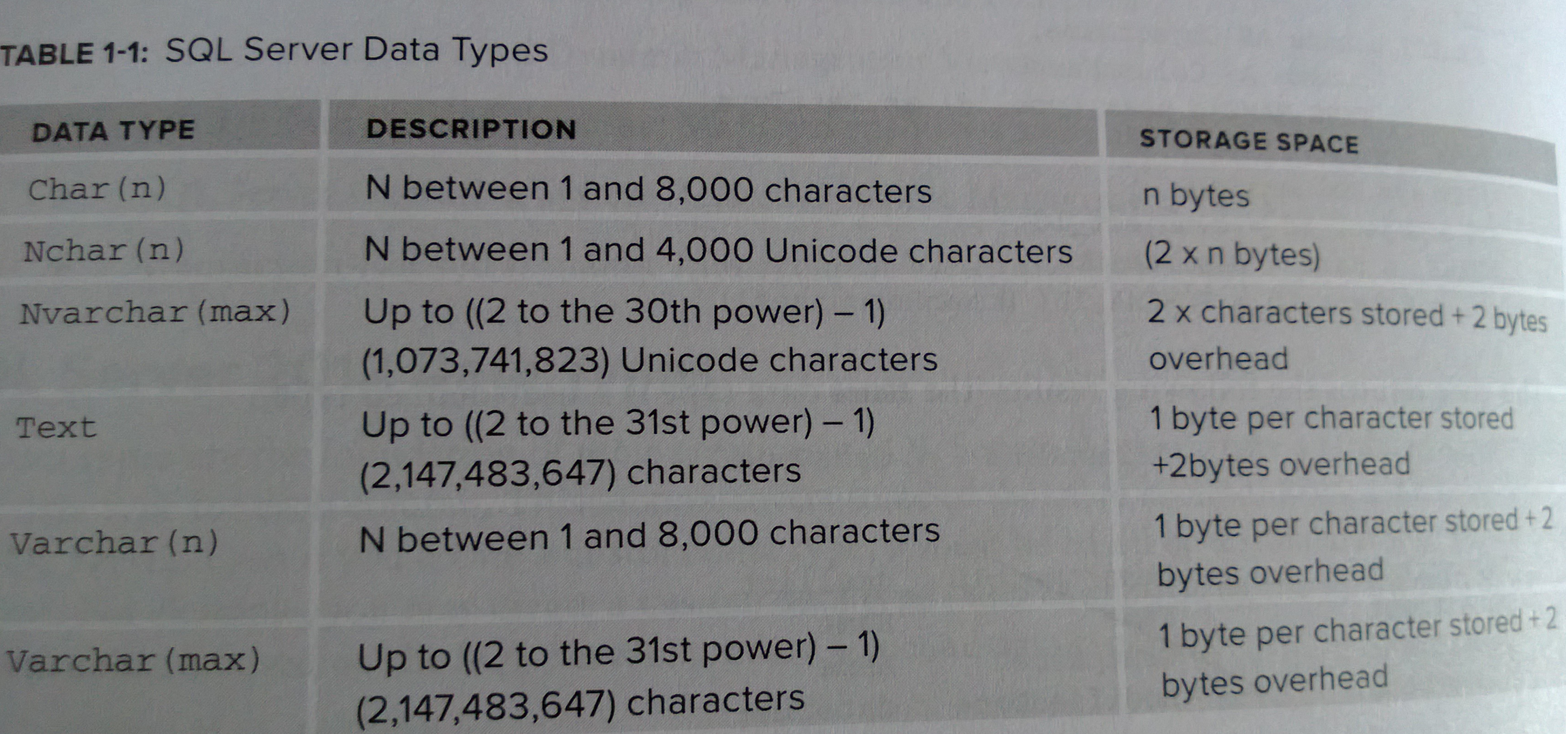
Data Types

Slide 20
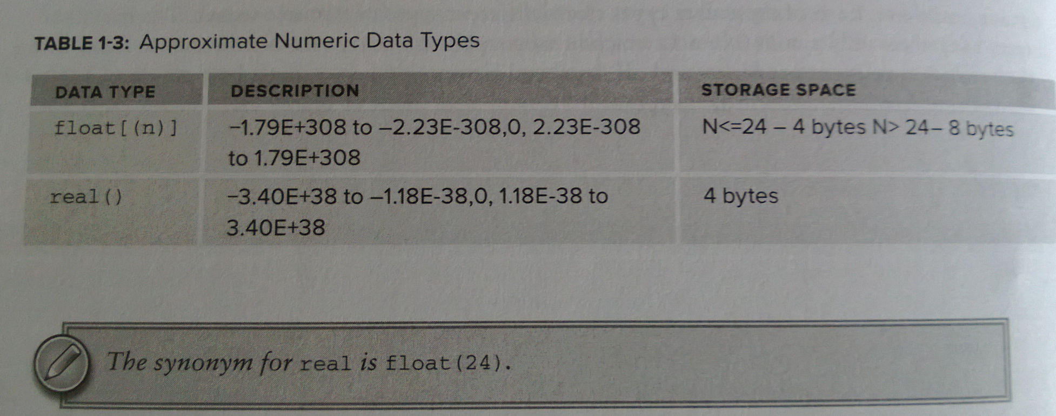
Data Types

Slide 21
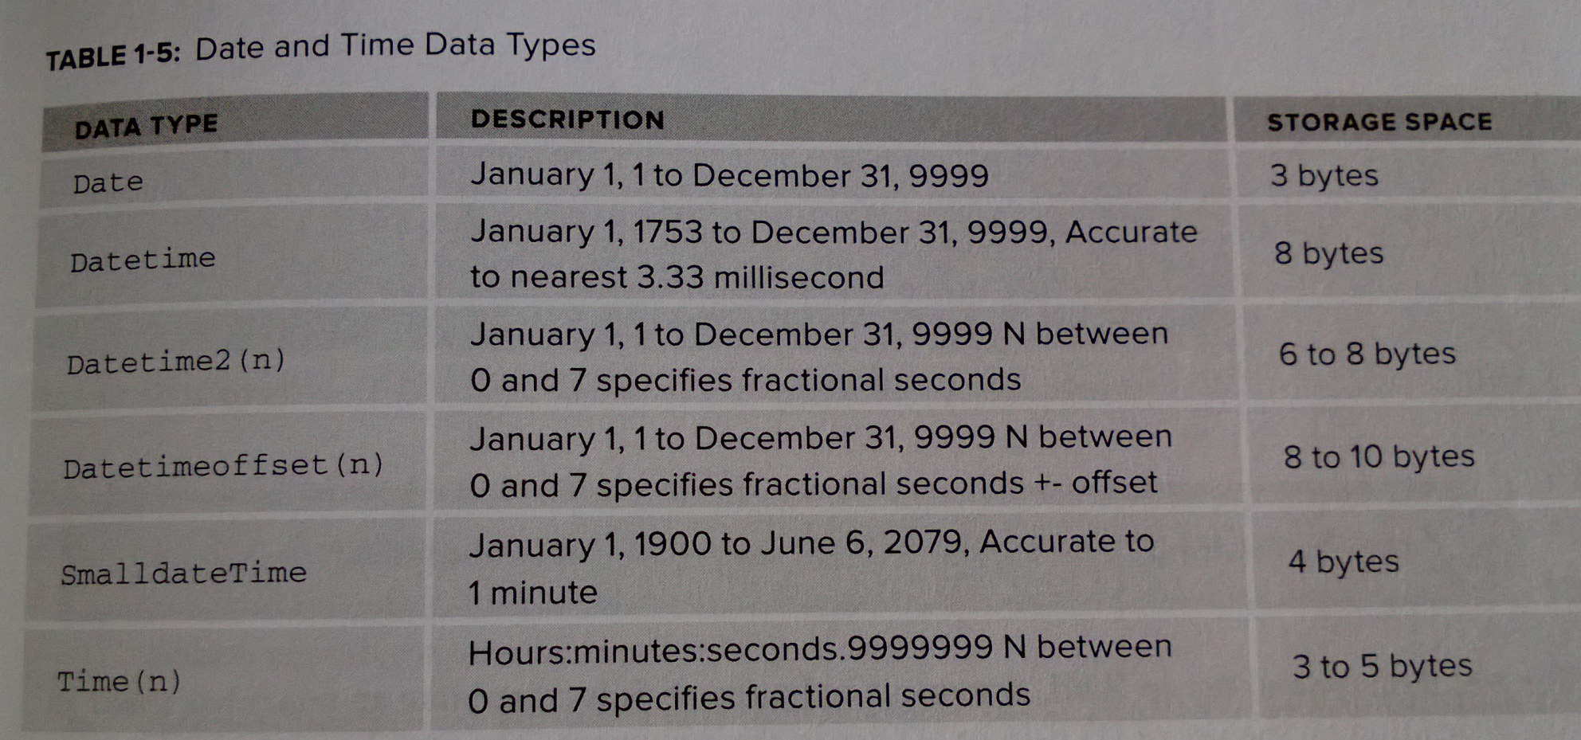
Data Types

Slide 22
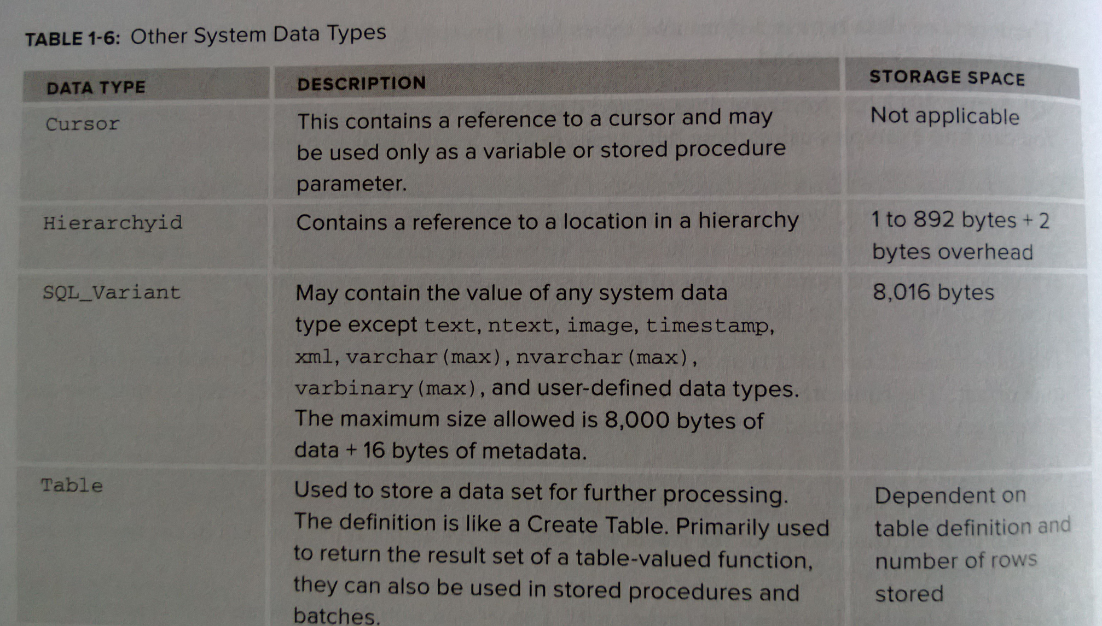
Data Types

Slide 23
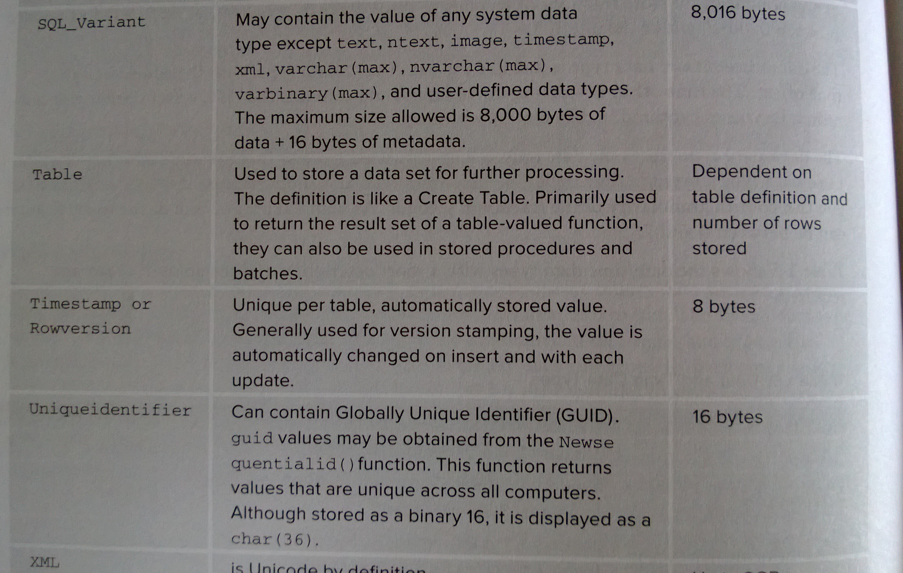
Data Types

Slide 24
Installation
Server configuration
Memory
Storage
Raid 0 – 2 or more disks form large volume
Raid 1 – Data written identically to two devices
Raid 1+0 – Mirrored sets or striped sets. Uses only half of actual storage
Raid 0+1 – Striped sets in mirrored sets. Less tolerant then Raid 1+0
Raid 5 – Tolerates 1 drive fault. Writes are distributed among drives. Faster reads, slower writes. Lost storage space.
Raid 6 – Tolerates two drive failure. Faster reads slower writes then Raid 5 due to overhead of parity calculation. Similar storage loss as in Raid 5.

Slide 25
Installation
DAS (Direct –Attached Storage)
Easier to implement
Easier to maintain
Lower cost
Limited scalability
Sisk space
Maximum disk size
Number of servers that they can attach to
Distance from storage units to server

Slide 26
Installation
SAN (Storage Area Network)
High speed access to data Fiber Channel (FC)
iSCSI protocols using Ethernet switches
Large geographic area
TCP/IP and wide area network (WAN)
Storage replication for Disaster Recovery
SAN reliability and scalability and increased I/O then DAS (direct attached storage)
Incredibly high cost

Slide 27
Configuration
Collation specifies rules for
Storage
Sort
Character comparison
Windows Collation is based on dictionary presently installed in operating system.
Case-Sensitivity
Upper case and Lower case are considered as different characters
Sort Order will treat upper and lower characters differently

Slide 28
Configuration
Service Account
Windows or Domain Account is preferred account type
Local Server Account is most secure but will not have access to network resources
Should not be used:
Local System Account
Local Service Account
Network Service Account
They all lack security and passwords

Slide 29
Configuration
Memory:
Minimum 0
Maximum 2,147,483,647 MB
Minimum memory never released to OS
If minimum set very high then it can starve OS and local processes
Maximum should be at least 1MB less then total maximum. OS needs memory as well.

Slide 30
Configuration
Default network packet size for SQL Server 2012 is 4,096 bytes.
Increasing this size improves performance specifically with large number of bulk operations
You will see bulk operations later

Slide 31
Installation
Tempdb:
Bulk load operations with triggers
Event notification
Index rebuild
Partial index sort
Large object type variables and parameters
Multiple active result set operations
Row versioning
Bigger tempdb is better for performance
Tempdb will grow eventually but giving it more space increases performance immediately
Best if completely isolated from other database and log files

Slide 32
Configuration
Model and User Databases
Set to Autogrow
Never set AutoShrink
Set a size lager and closer to what you need
Growth is extremely expensive and time consuming

Slide 33
Configuration
SA – your System Administration account
Should be protected with strong password including $ ! _ and alphanumeric
Never share SA account
Never write password on monitor
Never write password and carry it with you

Slide 34
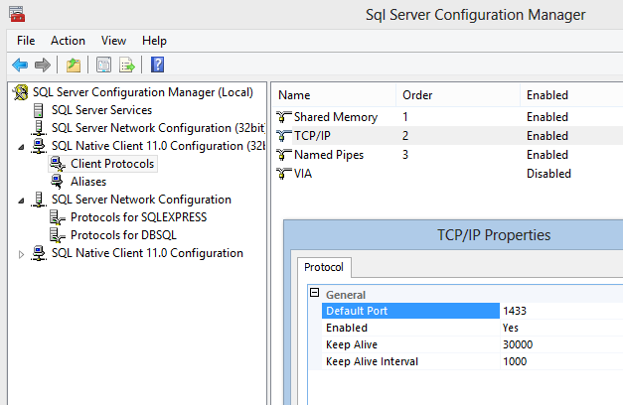
Configuration
SQL Server uses TCP/IP port 1433 to communicate with clients
Use Configuration Tool to configure it

Slide 35
Configuration
Always install latest service pack.
Service pack will have different fixes
Maximum row size
Ability to import bigger files
Bug fixes
Improvements

Slide 36
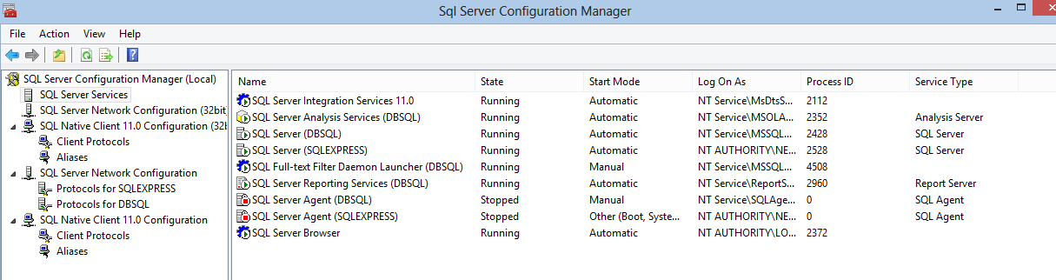
Configuration
SQL Services section allows you to control which services are turned on and how they are starting. If SQL is not running it may be good idea to check this screen first.

Slide 37
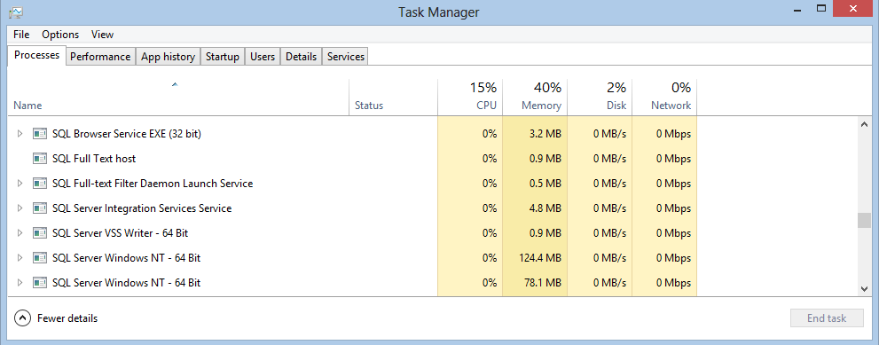
Configuration
Another good place is you trusted Task Manager. It will show current tasks that are running.

Slide 38
Configuration
Backup
Backup
Backup
Without backup your life as DBA will be over very shortly.
Store backups in safe place.
Always have 2 separate places that you store your backups
Have off line storage
2+ geographical locations are preferred
2+ different backup providers
Full and incremental backup
Store a specific number of backups depending on retention period that is required
Very old backups will not save your job
Backup
Backup
Backup

